Slide 1
Factors of Real Estate Prices
Aaron King

Slide 2
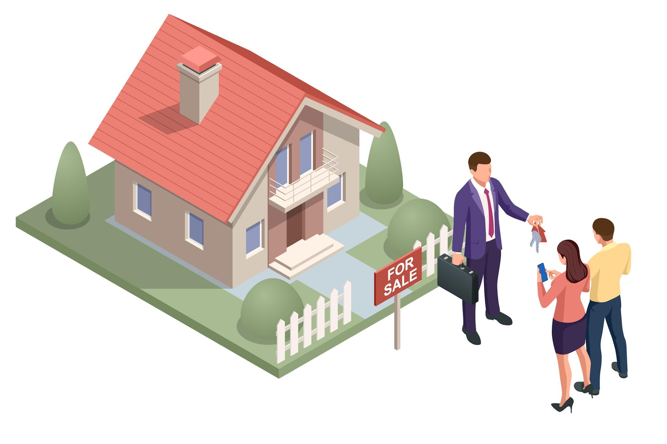
Data Overview
The data includes 1460 homes sold between 2006 and 2010. After removing 5 outliers, that gives us 1455 homes.
One new variable was created – Total_SF – that combined sq ft measurements from the basement, 1st, and 2nd floors of each house.
The CentralAir variable was adjusted from values of “Y” and “N” into a HasCentralAir term with respective values of “1” and “0”.
Notes:
Our data had 27 variables:
SalePrice - selling price of the house.
LotArea - area of the lot of the house
TotalBsmtSF - basement square feet
1stFlrSF - 1st floor square feet
2ndFlrSF - 2nd floor square feet
FullBath - # full bathrooms
HalfBath - # half bathrooms
BedroomAbvGr - # bedrooms above ground
TotRmsAbvGrd - # rooms above ground
Fireplaces - # of fireplaces
GarageCars - # car spots in garage
WoodDeckSF - square feet of wooden deck
OpenPorchSF - square feet of open porch
EnclosedPorch - square feet of enclosed porch
3SsnPorch - square feet of 3 season sunroom
ScreenPorch - square feet of screen porch
PoolArea - area of pool (if one exists)
YearBuilt - year of house built
YearRemodAdd - year of house remodeling
YrSold - year house was sold
Total_SF - ADDED VARIABLE: sq feet of basement, 1st floor, and 2nd floor
HasCentralAir - ADDED VARIABLE: a binary “1” or “0” value based on whether the house has Central Air
The outliers were removed based on either outlying sale price, outlying size of house, or outlying number of rooms above ground level.

Slide 3
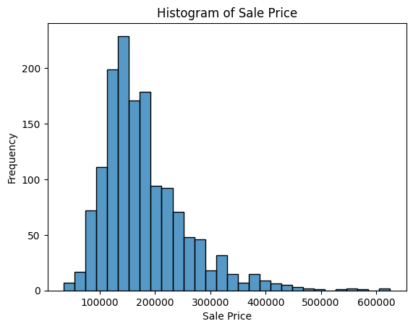
This histogram shows us the distribution of sales prices for homes in the dataset that we are observing.
Notes:
The distribution is skewed to the right, with most of the sales coming between 100000 and 300000. It’s informative to at least envision what the distribution of our explanatory variable is, and helped me find outliers. It also indicates that this regression model may not be useful for more expensive housing markets, as we don’t have a lot of data for higher-selling homes.

Slide 4
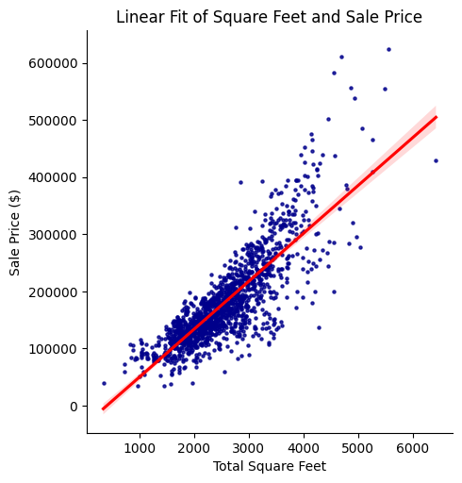
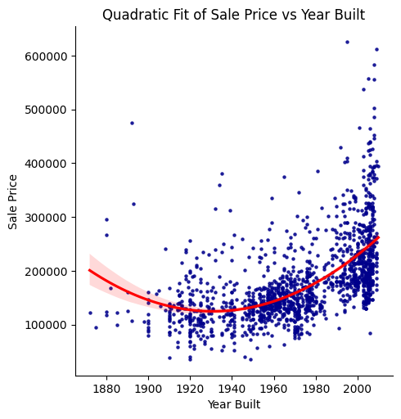
Key Variable Relationships
Notes:
These are two of our key variables. I chose to represent these with lines of best fit that I would be using for the model. The total square feet variable is modeled in the graph on the left, and a quadratic fit was applied to the year built model to the right. I thought a quadratic variable was appropriate to add because we can see that the data begins to increase sharply after 2000. I believe that this quadratic fit incorporates the “sticker shock” value of newly built homes. As time passes and those homes resell, I imagine that the price will drop as long as there is a continuous supply of newly built homes. In a sense, I don’t expect the trend from 1980 to 2000 to continue for forever, but it’s a good enough metric to help us figure out how much a home would sell for today (rather than 30 years from now.)

Slide 5
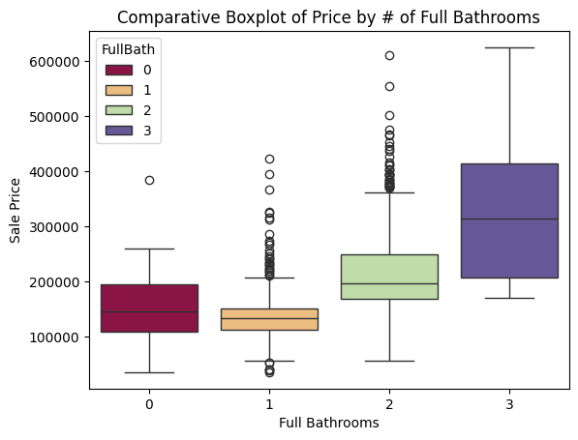
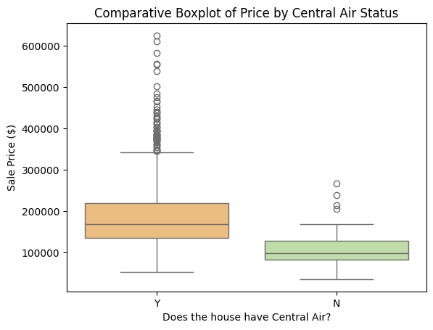
Other Key Variable Relationships
Notes:
These two variables were also added to our model. I thought that Full Bathrooms could be a useful predictor of Sale Price, as it would be logical to reason this. The correlation between price and # of Full Bathrooms was 0.56, which is pretty solid evidence of a relationship, and the box plot shows a continuously increasing relationship with price. As for Central Air status, there is clear evidence that having a central air unit improves the sale price of a house.

Slide 6
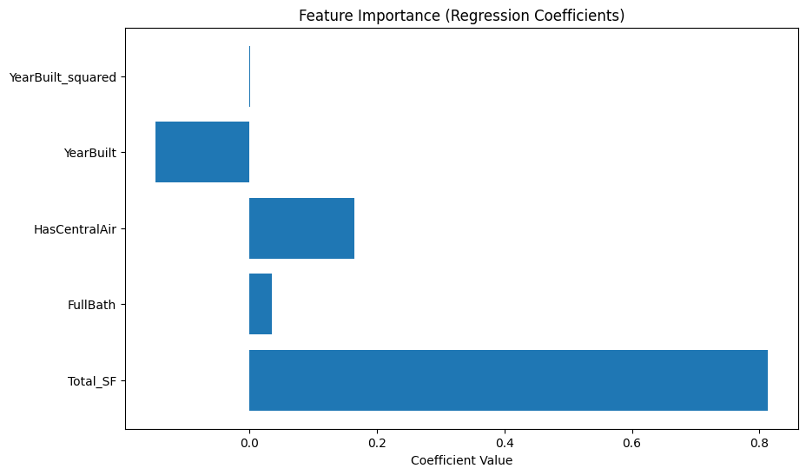
Our Regression Model
77.8% of the variation in sale price can be explained using this model.
Notes:
The full regression is in the .ipynb slides, and given that the real estate agents have no stats background, I thought that even giving them an equation to look at may be too confusing. So I plotted the magnitude of the coefficients (obviously not perfect, because total_Sf and yearbuilt_squared are not linear), but a good enough estimation. YearBuilt being negative doesn’t phase me much because the yearbuilt squared value is positive (even though it looks only very very slightly so) and has a big effect on home value in the model. Other variables with low correlation with our Y were removed, and TotRmsAboveGround and GarageCars were also considered, but ultimately left out due to them not significantly impacting our adj R-squared and worsening the fit of our Q-Q plot.

Slide 7
Our Regression Model
Coefficient of ln(Total_SF) = 0.8129: This means that a 10% increase in total square footage is associated with approximately a 8.13% increase in the sale price, holding other factors constant.
Coefficient of HasCentralAir = 0.1648: This means that if a house has central air, the expected percentage increase in the sale price is approximately 16.48%, holding other factors constant.
Coefficient of FullBath = 0.0346: This means that for each additional full bathroom, the expected percentage increase in the sale price is approximately 3.46%, holding other factors constant.
For understanding the impact of YearBuilt in the model, the coefficients for the variable and its squared term are not necessarily informative for a real estate agent like yourself. But, for example, moving from a house built in 1950 to one built in 2000 is associated with an approximate 27.1% increase in the sale price, holding other factors constant.
Ultimately, I recommend that you invest in selling newer built, more spacious houses with a central air system and a fair number of full bathrooms.
Notes:
I don’t have much else to add here – this is the only writing-intensive slide I have, but I knew that I needed to put the model into some sort of word format. My recommendation is right at the bottom.

Slide 8
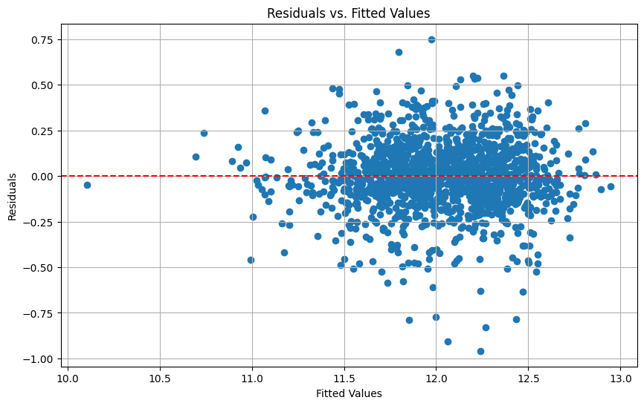
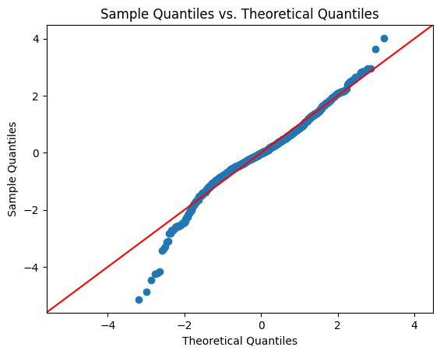
Our Regression Model
The graphs above display the distribution of the residuals given our model.
Notes:
I would try to explain that the Q-Q plot gives us an estimate of how the values match up to the theoretical values in our Y-variable of the model. I tried many different models to make the Q-Q plot as linear as possible, but there were almost always some very wide residuals on the negative side. On the left side of the slide, we have a plot of the residuals, and to me it looks about as random as can be reasonably expected. Overall, I think the model does a good job of interpreting our x variables. Other variables such as Total Rooms Above Ground and # of Car Garage Spots were considered, but they did a worse job of predicting outliers.

Slide 9
Predicted Sale Prices of 2011 Homes
House ID | Predicted Sale Price
11_1 | $148,751
11_2 | $173,484
11_3 | $213,019
11_4 | $280,724
11_5 | $96,790
These predictions were made using our regression model.
Notes:
This slide is pretty self-explanatory – I ran the new data through a predictor and it popped out these values. I would continue to assert my recommendation that if you want to sell more expensive homes, they need to be newly built, lots of square footage (and bathrooms as part of that square footage), and have central air conditioning.

